Slide 1

Databases
A2 Digital Technology

Slide 2
What do we need to know?
describe the main features of a relational database;
describe the difference between a logical data model and a physical data model;
define the terms attribute, entity, primary key, composite key, foreign key, relationships, referential integrity, data duplication and data inconsistency;
produce an entity-relationship (ER) model from the given data requirements for a scenario;
describe the characteristics of data in un-normalised form, first normal form (1NF), second normal form (2NF) and third normal form (3NF);
describe the advantages and disadvantages of normalisation;
normalise data requirements for a scenario to 3NF;
describe the components of a data dictionary;
use Structured Query Language (SQL) to create tables and to retrieve, update, insert and delete data in a relational database;
evaluate Query By Example (QBE) as an alternative to SQL.

Slide 3
What is a database?
A database is a collection of data items structured so that data can be searched and retrieved when necessary.
  An address book containing names, addresses and telephone numbers is an example of a simple database.
  They are structured in a way that allows it to be accessed by a number of different application programs.
Data can be held in a flat file structure where the entire database is stored in a single file and there is one row for each record and one column for each field.
  This type of structure leads to data being repeated unnecessarily (redundancy) and therefore it is not efficient.
  It is a single database table, consisting of rows and columns, in which all the information is held. It has a lot of data duplication, can have data inconsistency, of which leads to having poor data integrity compared with a relational database.
Relational databases store data more efficiently.
  This is where data can be stored across a number of tables, with tables linked together using relationships (common fields).
  Data can be retrieved from multiple tables from a single query
  Less data redundancy

Slide 4
An example of a database
Fields are the columns. They are referred by their field name.
StudentID | StudentName | Subject | Teacher | Room
1 | Alex | Art | Mr Jobs | T1
1 | Alex | Maths | Mr Spielberg | T2
1 | Alex | Physics | Miss Swift | T3
2 | Peter | Maths | Mr Spielberg | T2
2 | Peter | Geography | Mrs Franklin | T1
3 | Richard | Maths | Mr Spielburg | T2
3 | Richard | Physics | Miss Swift | T3
3 | Richard | English | Miss Sweet | T4
3 | Richard | Art | Mr Jobs | T1
Each row is called a record.
A Data item is held in each field of the database record.
Notes:
More detailed definitions will be on next slide

Slide 5
Definition List
Key field
  The field within a record used to identify the record, for example a bank account number identifies a customer’s account.
  AKA primary key. A field used to uniquely identify a record within a database table.
  Some tables require two or more fields to be used together to uniquely identify a record. These are rare, however are called a composite primary key
Record
  The basic unit of data stored in a data file. It is a collection of items, which may be of different data types, all relating to the individual or object the record describes and is treated as a unit for processing.
Field
  Part of a record designed to hold a single data item of a specified type. Each field is referred to by a field name, which identifies the data in the field and makes it possible to generalise about the data being processed

Slide 6
Flat File Databases
You may sometimes here of the term ‘flat file’ when using databases. What does that mean exactly?
It means that the database is held as a single table and stored in a single file. The data will be structured with a row for each record and a column for each field.
StudentID | StudentName | Subject | Teacher | Room
1 | Alex | Art | Mr Jobs | T1
1 | Alex | Maths | Mr Spielberg | T2
1 | Alex | Physics | Miss Swift | T3
2 | Peter | Maths | Mr Spielberg | T2
2 | Peter | Geography | Mrs Franklin | T5
3 | Richard | Maths | Mr Spielburg | T2
3 | Richard | Physics | Miss Swift | T3
3 | Richard | English | Miss Sweet | T4
3 | Richard | Art | Mr Jobs | T1

Slide 7
What’s wrong with this?
Did you notice the issue here?
Well, it’s a really inefficient way to store data in a flat file and leads to issues with typing out data over and over again.
StudentID | StudentName | Subject | Teacher | Room
1 | Alex | Art | Mr Jobs | T1
1 | Alex | Maths | Mr Spielberg | T2
1 | Alex | Physics | Miss Swift | T3
2 | Peter | Maths | Mr Spielberg | T2
2 | Peter | Geography | Mrs Franklin | T5
3 | Richard | Maths | Mr Spielburg | T2
3 | Richard | Physics | Miss Swift | T3
3 | Richard | English | Miss Sweet | T4
3 | Richard | Art | Mr Jobs | T1
This spelling error is an example of data inconsistency. There are potentially three issues when using flat file databases.

Slide 8
Data duplication
Duplicate copies of data – we would have to key in Tanya Travels Website 3 times. This wastes storage space and means that data is redundant or unnecessarily repeated.
Poor data Integrity
Data that is erroneous or inconsistent is not reliable. This is caused by the data being compromised in terms of accuracy.
Data inconsistency
The more often data has to be keyed the more chance there is for errors in data entry. In this case the data is inconsistent because Tanya is spelt differently in two different entries.

Slide 9
Relational Databases
In a relational database, data items aren’t repeated and are only stored once and in one location. This avoids having to maintain the same data in multiple locations.
The duplication of data is called data redundancy, which is kept to a minimum when using a relational database.
Realistically, the only thing that should be repeated in a relational database is the key fields in order to make the relationships between the tables.
Each table must have a unique reference field for each record (called a primary key). This uniquely identifies each record in a table.
Replicating a primary key into other tables creates a foreign key.
Foreign keys form the relationships that link the tables together.

Slide 10
Database Tables
A relational database has more than one table of data. The tables are joined through primary and foreign keys.
The key can join tables together in many different relationships, such as:
  a one-to-one relationship, where each table contains one unique record;
  a one-to-many relationship, where one table might contain records about an individual and the other might have records about all that individual’s financial transactions.
  Whilst many-to-many relationships are possible, they do not suit many database structures as this added ambiguity leads to increased data inconsistency and poor data integrity, so should be avoided!

Slide 11
StudentID | StudentName | Subject | Teacher | Room
1 | Alex | Art | Mr Jobs | T1
1 | Alex | Maths | Mr Spielberg | T2
1 | Alex | Physics | Miss Swift | T3
2 | Peter | Maths | Mr Spielberg | T2
2 | Peter | Geography | Mrs Franklin | T5
3 | Richard | Maths | Mr Spielburg | T2
3 | Richard | Physics | Miss Swift | T3
3 | Richard | English | Miss Sweet | T4
3 | Richard | Art | Mr Jobs | T1
We could split up the table into two sections, fixing the issue where we are duplicating data.
We can also fix the spelling errors and room issues as they appear.
However, now we have two separate tables, but they have no link to one another – we have lost meaning.
For example, we don’t know what subjects Alex is studying.
Subject | Teacher | Room
Art | Mr Jobs | T1
Maths | Mr Spielberg | T2
Physics | Miss Swift | T3
Geography | Mrs Franklin | T5
English | Miss Sweet | T4
StudentID | StudentName
1 | Alex
2 | Peter
3 | Richard

Slide 12
StudentID | StudentName
1 | Alex
2 | Peter
3 | Richard
We first can set up a primary key in both tables.
Subject | Teacher | Room
Art | Mr Jobs | T1
Maths | Mr Spielberg | T2
Physics | Miss Swift | T3
Geography | Mrs Franklin | T5
English | Miss Sweet | T4
Now we have to link these via a relationship.
This is done by drawing a line between the two tables.
SubjectID (🔑) | Subject | Teacher | Room
1 | Art | Mr Jobs | T1
2 | Maths | Mr Spielberg | T2
3 | Physics | Miss Swift | T3
4 | Geography | Mrs Franklin | T5
5 | English | Miss Sweet | T4
StudentID (🔑) | StudentName
1 | Alex
2 | Peter
3 | Richard
This hasn’t fixed anything yet. We need to decide how many records in one table can be related to another.
This is called degrees of relationship and come in three formats:
  One to one
  One to many
  Many to many

Slide 13
On the ‘many’ side, we can add an ∞ symbol
SubjectID (🔑) | Subject | Teacher | Room
1 | Art | Mr Jobs | T1
2 | Maths | Mr Spielberg | T2
3 | Physics | Miss Swift | T3
4 | Geography | Mrs Franklin | T5
5 | English | Miss Sweet | T4
StudentID (🔑) | StudentName
1 | Alex
2 | Peter
3 | Richard
∞
Can teach multiple students…
…So we can add the crows foot on this side also.
One subject/teacher…
One record here, for example Alex…
It can alternatively be represented via this shape called a crows foot.
Can relate to many records here.
For example, Alex can study many subjects.
We then need to repeat this process the other way around, to get the other side of the relationship (it’s a two-way relationship)
This type of relationship is an example of a many-to-many relationship.
We still haven’t solved the issue though that this hasn’t re-gained the information of what students takes what subject. A many-to-many relationship needs to be fixed!

Slide 14
To fix this many to many relationship, we can add in a middle table (called a derived table).
SubjectID (🔑) | Subject | Teacher | Room
1 | Art | Mr Jobs | T1
2 | Maths | Mr Spielberg | T2
3 | Physics | Miss Swift | T3
4 | Geography | Mrs Franklin | T5
5 | English | Miss Sweet | T4
StudentID (🔑) | StudentName
1 | Alex
2 | Peter
3 | Richard
And now we need to invert the crows feet into this derived table for it to make sense.
We now link the two original tables to this derived table.
Whilst one record here
This same logic works on this relationship also
Relates to only a single record here
StudentID (FK) | SubjectID (FK)
1 | 1
1 | 2
1 | 3
2 | 2
2 | 4
3 | 2
3 | 3
3 | 5
3 | 1
SubjectID (🔑) | Subject | Teacher | Room
1 | Art | Mr Jobs | T1
2 | Maths | Mr Spielberg | T2
3 | Physics | Miss Swift | T3
4 | Geography | Mrs Franklin | T5
5 | English | Miss Sweet | T4
StudentID (🔑) | StudentName
1 | Alex
2 | Peter
3 | Richard
One student appears in multiple records in this derived table
We now have a database structure without many-to-many relations and can keep the information on who studies what subject

Slide 15
This certainly isn’t a perfect example; but it gives you an idea of how we can store data in a smarter way.
There is no duplication of data (other than primary keys). In the example, we have created two foreign keys, which means it is a field in one table that references (and is) the primary key in another table.
These two fields are then used together to form a primary key (and since it’s using more than one field to make a primary key, it’s now termed a composite primary key.
StudentID (FK) | SubjectID (FK)
1 | 1
1 | 2
1 | 3
2 | 2
2 | 4
3 | 2
3 | 3
3 | 5
3 | 1
(🔑)
(🔑)
SubjectID (🔑) | Subject | Teacher | Room
1 | Art | Mr Jobs | T1
2 | Maths | Mr Spielberg | T2
3 | Physics | Miss Swift | T3
4 | Geography | Mrs Franklin | T5
5 | English | Miss Sweet | T4
StudentID (🔑) | StudentName
1 | Alex
2 | Peter
3 | Richard

Slide 16
What sort of data can I store in a database?
Using a relational database a name and data type for each field can be specified. As well as data types, database systems allow you to apply further constraints such as specifying a maximum length or enforcing the uniqueness of a field. Constraints help control data integrity and prevent problems such as:
  entering a Project Name (text) in a field where a Project Number is expected.
  entering a Start Date in the last century.
  having two projects with the same Project ID.
  entering a number in the Star+-98t Date field.
  entering a Pay Grade which does not exist.
  Maintaining data integrity.
The features which allow us to set field properties, link tables and set constraints help to increase the reliability of the data.
It is also possible to provide access rights to different users depending on their role. Some roles allow for CRUD (Create Read Update Delete) functions on the data in tables. These functions are often implemented through SQL (Structured Query Language).

Slide 17
🐝Buzz words!
🍯 Attribute
An individual data item within an entity.
For example, Employee Name in an entity called EMPLOYEE.
This is also known as a field.
🍯 Entity
Identifies an object about which data will be stored within the system. An entity could be described as a person, place, thing, or event which has relevance to the database.
For example, an EMPLOYEE or a PROJECT. Another name for an entity is a table in the relational model. Note when describing an entity, singular names are used.
An entity occurrence is an instance of the entity.
🍯 Primary Key
A primary key consists of one or more attributes that identifies one record from any other.
For example, the Employee No would uniquely identify each employee in a table.
🍯 Composite Key
Consists of more than one attribute to uniquely identify an entity occurrence or record.
🍯 Foreign Key
A foreign key is a primary key in one entity which is included in another entity to link the two tables.
🍯 Relationships
A relationship is an association of entities. A relationship is established by a foreign key in one entity linking to the primary key in another.
The degree or cardinality of a relationship is the number of occurrences in one entity which are associated to the number of occurrences in another. The degree of relationship can be:
  One-to-One (1:1)
  One-to-Many (1:M)
  Many-to-Many (M:N)
🍯 Referential Integrity
Referential integrity ensures that the data in one table does not contradict the data in another table. Specifically, every foreign key value which exists in a table must have a matching primary key value in a related table. This is used to manage the relationships between primary and foreign keys.

Slide 18
Data Dictionaries
Field Name | Data Type | Field Size | Format / Input Mask | Default Value | Description | PK / FK
Product ID | Autonumber | - | - | - | Used to uniquely scan product barcode | PK
Product Name | String | 20 | >L<LLL??????????????? | - | Used to describe product to customer | -
Product Size | String | 6 | Lookup List (Small/Medium/Large) | “Medium” | Used to display overall size to customer | -
Price (£) | currency | 4 | ###:## | £1.00 | Used for price calculation for orders | -
A file containing descriptions of, and other information about, the structure of the data held in a database.
The data dictionary is not usually accessible to users.
Typically, it contains such items as fieldname, data type, field size, format, default value, input mask, whether a primary key/foreign key

Slide 19
Data Modelling
Database design is about identifying the relationships between data and creating a logical design which is best suited to the data required for a system.
ER Models (Entity-Relationship Modelling)
Data modelling is used when designing relational databases. Within the process of data modelling, Entity Relationship (ER) diagrams are produced, and plans for the table design are constructed.
The first step in designing a database is to identify and state what data needs to be stored.
From the statement of data requirements, a conceptual data model is produced. This describes how the data elements in the database are to be grouped.
The terms used in building a picture of the data requirements are Entity, Attribute and Relationship.
Following this, the ENTITY-RELATIONSHIP (ER) diagrams are produced.

Slide 20
Logical Data Models VS Physical Data Models
Logical Data Models
Physical Data Models
When creating a logical data model entities and their relationships are identified with the keys.
The attributes of each entity are also identified. A logical data model does not describe the physical structure of the real database.
A physical data model is derived from the logical
data model and includes the specification of all
tables and the columns (fields) inside them.
The physical data model contains the primary keys of each table and it specifies the relationship between the tables using foreign keys.
The physical implementation will differ based on
the actual database management system used.

Slide 21

ER Diagrams
How to draw ER Diagrams
Create a box for each entity relevant to the model
Model the relationships between each entity by drawing lines to connect the related entities.
Label the relationships using verbs
Use crows foot notation to illustrate the cardinality of the relationships
Identify relevant attributes within important entities (PK/FK)
Note that many to many relationships cannot be implemented in a relational database so these should be resolved prior to developing the physical model.
ER diagrams (short for Entity-Relationship diagrams) are used primarily in database design to visually represent the structure of a database.
They help model the data and the relationships between different entities in a system.
Many-to-many relationships cannot be implemented in a relational database

Slide 22
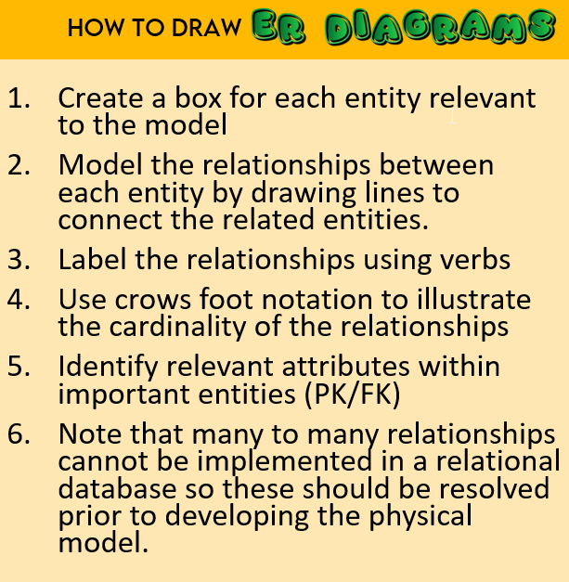
Let’s have a go at drawing an ER diagram with the information below.
In a school, students can take many different subjects. Teachers move between different subject classrooms and can be assigned at least one subject each year. A teacher moves between two sites, Site 1 and Site 2.
CHALLENGE
Create an ER diagram to represent this scenario.
You have 10 minutes.

Slide 23
STEP : List the Entities
In a school, students can take many different subjects. Teachers move between different subject classrooms and can be assigned at least one subject each year. A teacher moves between two sites, Site 1 and Site 2.
student
subject
classroom
teacher
site
The entities are:
Student
Subject
Classroom
Teacher
Site
Student
Subject
classroom
Teacher
Site

Slide 24
STEP : Model the relationships
In a school, students can take many different subjects. Teachers move between different subject classrooms and can be assigned at least one subject each year. A teacher moves between two sites, Site 1 and Site 2.
Student
classroom
Subject
Site
Teacher

Slide 25
STEP : label the relationships
In a school, students can take many different subjects. Teachers move between different subject classrooms and can be assigned at least one subject each year. A teacher moves between two sites, Site 1 and Site 2.
Student
learns
Taken in
classroom
Subject
Located in
teaches
Site
Teacher

Slide 26
STEP : Set up Cardinality
In a school, students can take many different subjects. Teachers move between different subject classrooms and can be assigned at least one subject each year. A teacher moves between two sites, Site 1 and Site 2.
Student
learns
Taken in
classroom
Subject
Located in
teaches
Site
Teacher

Slide 27
STEP : Identify Primary Key/foreign Key
In a school, students can take many different subjects. Teachers move between different subject classrooms and can be assigned at least one subject each year. A teacher moves between two sites, Site 1 and Site 2.
We could go straight into the Primary Key and Foreign key now, but I can see an issue already with this ER diagram.
Student
learns
Taken in
classroom
Subject
Located in
Let’s fix these first!
teaches
Site
Teacher

Slide 28
STEP : Deal with Many to Many relationships
In a school, students can take many different subjects. Teachers move between different subject classrooms and can be assigned at least one subject each year. A teacher moves between two sites, Site 1 and Site 2.
Student
I have removed the verbs just for a moment to look at how this has changed.
Enrolment
classroom
Lesson
Subject
This is much clearer!
Site
Teacher

Slide 29
STEP : List the relevant attributes
In a school, students can take many different subjects. Teachers move between different subject classrooms and can be assigned at least one subject each year. A teacher moves between two sites, Site 1 and Site 2.
Student
🗝️ StudentID
The Lesson attribute has received its own primary key. This is because it would get very messy with multiple foreign keys being used to make a primary key here.
Enrolment
🗝️ StudentID 🗝️ SubjectID
Classroom
🗝️ ClassroomID
SiteID (FK)
Lesson
🗝️ LessonID
SubjectID (FK)
ClassroomID (FK)
TeacherID (FK)
Subject
🗝️ SubjectID
You could argue that Enrolment could also have its own primary key, instead of a composite key.
Site
🗝️ SiteID
Teacher
🗝️ TeacherID

Slide 30
Challenge
Details about student examination results are stored in a relational database. The data held about some students is shown below.
Draw a fully labelled ER diagram, which does not contain any many-to-many relationships, for the system. [5]
Student ID | Student Name | Exam ID | Exam Name | Result
167 | O’Hare C | C12 | Chemistry | Grade A
 |  | P14 | Physics | Grade C
114 | Black P | B12 | Biology | Grade B
 |  | P14 | Physics | Grade A
321 | Morrison R | B12 | Biology | Grade A
 |  | P14 | Physics | Grade B
 |  | C12 | Chemistry | Grade C

Slide 31

Challenge: Mark Scheme
Details about student examination results are stored in a relational database. The data held about some students is shown below.
Draw a fully labelled ER diagram, which does not contain any many-to-many relationships, for the system. [5]
Student ID | Student Name | Exam ID | Exam Name | Result
167 | O’Hare C | C12 | Chemistry | Grade A
 |  | P14 | Physics | Grade C
114 | Black P | B12 | Biology | Grade B
 |  | P14 | Physics | Grade A
321 | Morrison R | B12 | Biology | Grade A
 |  | P14 | Physics | Grade B
 |  | C12 | Chemistry | Grade C

Slide 32
NORMALISATION
describe the characteristics of data in unnormalized form, 1NF, 2NF & 3NF
describe the advantages and disadvantages of normalisation
normalise data requirements to 3NF

Slide 33
What is it?
Database normalization is the process of organising data within a database to reduce redundancy and improve data integrity.
It involves structuring data into tables and defining relationships between them according to a set of rules called normal forms.
This process ensures that data is:
  stored efficiently
  stored consistently
  easy to manage and query

Slide 34
Normalisation
The documents used within an organisation can be examined. Data to be stored can be identified from within the documents.
Normalisation involves the application of a set of rules to remove undesirable characteristics and problems and can be used to test the correctness of an ER model.
Normalisation will reduce data redundancy, storage space, and update anomalies such as insertion, deletion and modification. It improves the integrity of the data.
This is very different from a flat file database, which has issues:
  Un normalised data (like it is in a flat file) may have data redundancy
  It may have data inconsistencies
  It will have data duplication
To remove these issues and anomalies, we use normalisation. This is a bottom-up process.

Slide 35
Unnormalised Form (0NF)
To write data in UNF complete each of the following steps:
Select a name for the main entity
Each field contained within the entity is listed in brackets.
Primary keys are underlined.
Foreign keys are represented with *.
Repeating groups are contained within {}.
Derived attributes such as average Hourly Rate should not be included here but the developer may decide to store the value to improve performance.

Slide 36
Let’s look at an example
Order Number | Order Date | Customer Email | Customer ID | Customer Name | Product ID | Product Name | Product Price
1200 | 15/05/25 | hp@gmail.com | 0001 | H. Potter | 1000 | Chocolate | 50p
 |  |  |  |  | 1200 | Crisps | 80p
 |  |  |  |  | 1250 | Cola Can | 75p
1201 | 20/05/25 | leviOsa@ymail.com | 0002 | H. Granger | 1200 | Crisps | 80p
 |  |  |  |  | 1250 | Cola Can | 75p
1202 | 20/05/25 | broken@wand.com | 0003 | R. Weasley | 1000 | Chocolate | 50p
 |  |  |  |  | 1250 | Cola Can | 75p
 |  |  |  |  | 1300 | Chewing gum | 80p
 |  |  |  |  | 1400 | Wand | 99p
These are repeating groups

Slide 37
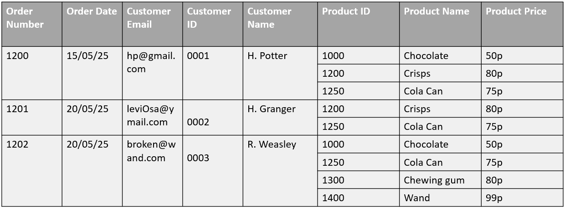
Let’s look at an example
This is a record. A record cannot be split into multiple rows like this, so we cannot use this structure to make a relational database. It will need to be reconfigured.
0NF
ORDER(Order Number, Order Date, Customer Name, Customer Email, Customer ID { Product ID, Product Name, Product Price} )
a repeating group refers to a set of attributes (columns) that appear more than once within a single record (row) of a table

Slide 38
1st Normal Form
Data is said to be in 1NF if all attributes are atomic and entities do not have repeating groups.
  Atomic means that the attribute cannot be further sub divided
Not Atomic
Atomic
A field called
Customer Name
Which holds first name and surname
Two fields
Customer First Name Customer Surname
It is now atomic

Slide 39
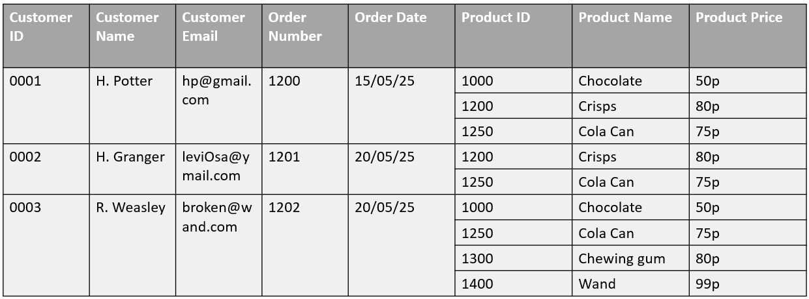
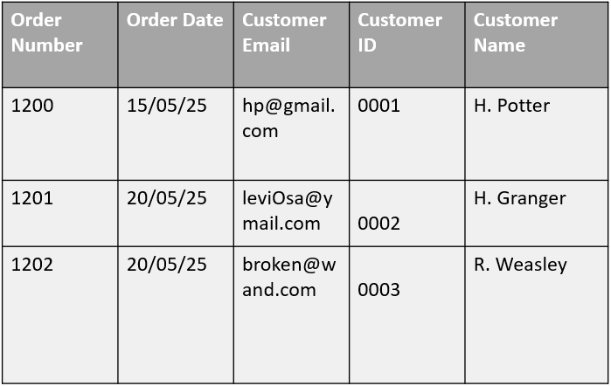
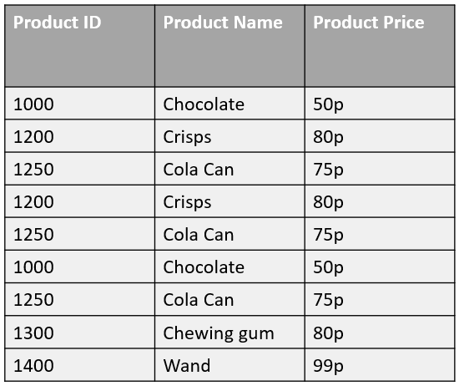
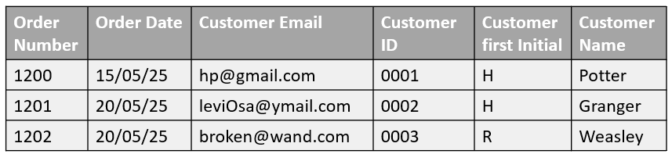
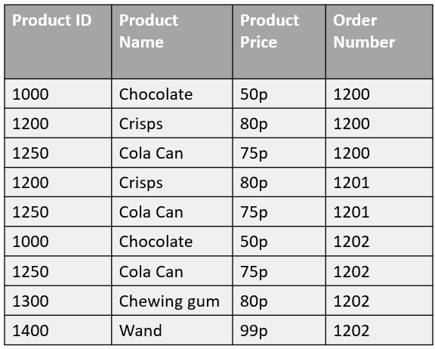
1NF
ORDER(Order Number, Order Date, Customer Email, Customer ID, Customer first Initial, Customer Name)
ORDER-PRODUCT(Product ID, Product Name, Product Price, Order Number*)

Slide 40
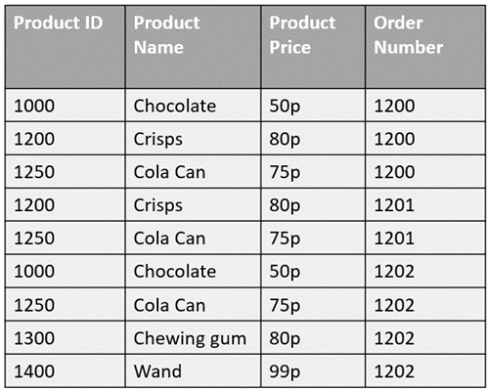
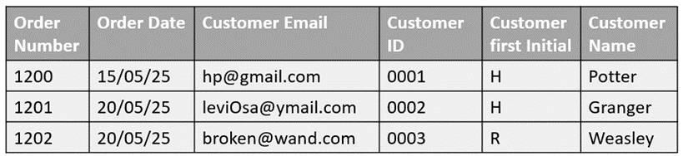
2nd Normal Form
Data is in 2NF if it fulfils the conditions for 1NF and all non-key attributes in the relation are fully dependent on the primary key.
  Non-key attributes are all of the other columns that are not part of the primary key/composite key
  Fully dependent means that the non-key columns depend on the entirely on the primary key, not just part of it (in the case of a composite primary key)
The aim of 2NF is to remove partial dependencies.
We need to remove the partial dependencies in this table. This is because customer first initial does not depend on the Order Number, but instead it links to the Customer ID.
There are also columns within this table that do not relate to the Order Number, which is a composite primary key here.

Slide 41
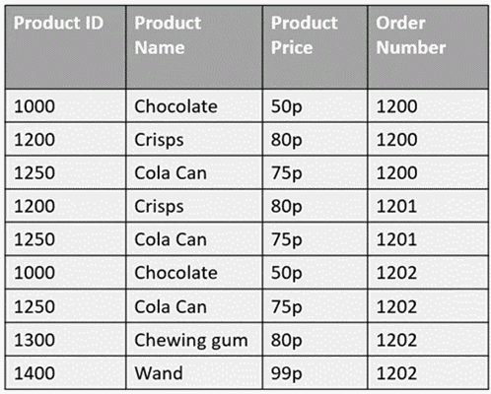
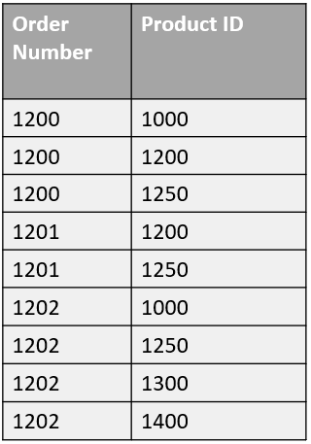
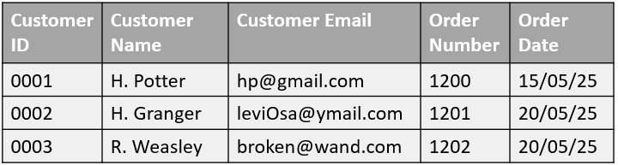
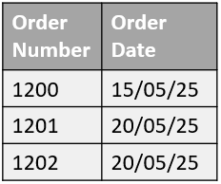
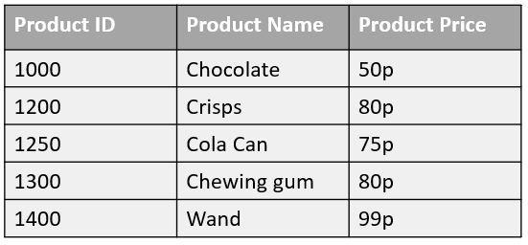
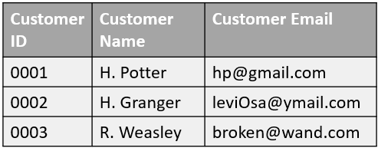
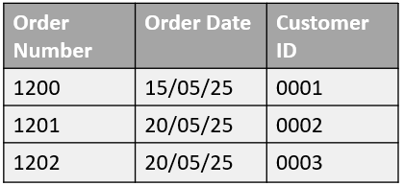
Non-key attributes which are only partially dependent on the key are removed to a new entity along with a copy of their determinant (key attribute on which they are partially dependent).
2NF
ORDER-PRODUCT(Product ID, Product Name, Product Price, Order Number*)
CUSTOMER(Customer ID, Customer Name, Customer Email)
ORDER(Order Number, Order Date, Customer ID*)
PRODUCT(Product ID, Product Name, Product Price)

Slide 42
3rd Normal Form
Data is in third normal form if it is in second normal form and there are no non-key dependencies.
  That is as long as an attribute does not depend on another attribute which is not the primary key.
This is called a transitive dependency.

Slide 43
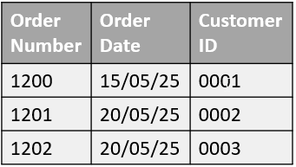
STEP 1: Ensure Data has no repeating Groups and atomic values
STEP 2: Ensure Data is in 3rd Normal Form
STEP 3: Ensure there are No transitive dependencies (Non-key attributes must depend only on the primary key, not on another non-key attribute.)
Customer ID = OK (Primary Key)
Customer Name = depends only on Customer ID
Customer Email = depends only on Customer ID
Order Number = OK (Primary Key)
Order Date = depends only on Order ID
Customer ID = OK (Foreign Key)
Order Number = OK (Primary Key)
Product ID = OK (Primary Key)
No other attributes.
Product ID = OK (Primary Key)
Product Name = depends only on Product ID
Product Price = depends only on Product ID

Slide 44
We can now insert the cardinality associated with each relationship.
We first link the primary kay and foreign keys with lines to represent the links
And we can then add a crows foot where a ‘many’ relationship appears.

Slide 45
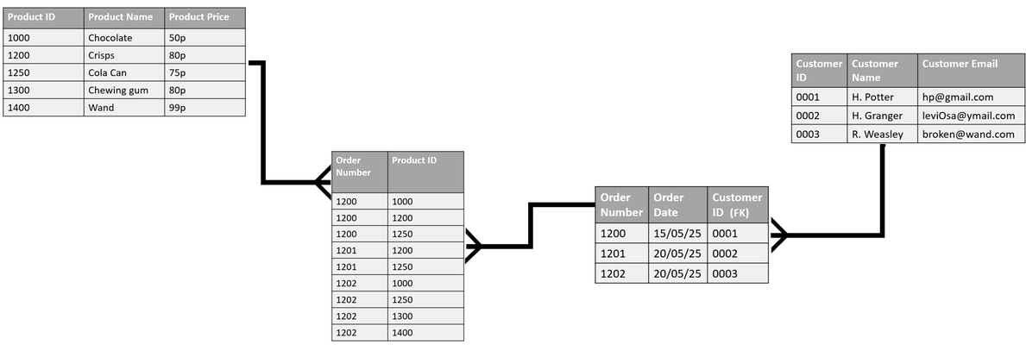
This Process comes with its benefits…
The resulting database will take up less storage space because the duplication of data is minimised.
Information retrieval will be more efficient because data is structured effectively.
Queries will be processed faster.
Less redundancy means less inconsistencies in data because data will only have to be entered once.
Data integrity will be increased.

Slide 46
… but also its drawbacks!
Normalisation is a complex process required to create the database structure.
Normalisation can generate more tables than an un-normalised database
More tables mean a more complex database and queries may be slow to run.
It is necessary to assign more relationships to interact with larger numbers of tables
With more tables, setting up queries can become more complex

Slide 47
Data Dictionaries
A data dictionary is a file containing descriptions of the structure of the data stored in a database.
The data dictionary contains:
  Attribute/ field names,
  data types,
  field size,
  format,
  default values,
  Entity/table names
  whether or not the field is a primary key
  Validation and input masks
A data dictionary can be used to provide metadata or ‘data about data’.
This allows identifiers to be attached to key data which can then be structured, retrieved and used.

Slide 48
Structured Query Language (SQL)
Structured Query language(SQL) and Query by Example(QBE) are both used to access and manipulate data in a database. SQL is used widely by programmers to interrogate databases efficiently.
QBE is a simple query language where the user creates a query using a form.
Criteria are entered into the form and the query is executed to return a set of data which fulfils the query.

Slide 49
Using SQL: Creating a Database
CREATE DATABASE
databasename;
This SQL creates a new database.
You can set the name of the database here

Slide 50
Using SQL: Creating a Table
CREATE TABLE table_name (
column1 datatype,
column2 datatype,
column3 datatype,
etc.
Primary Key (column2)
);
This SQL creates a new table within a database.
You can set the name of the table here
We can then give the list of fields stored and their datatypes
Finally, we can set a primary key of the table to a specified field

Slide 51
Using SQL: Retrieving Data from a Table
SELECT
column1,
column2,
column3
FROM
tableName
WHERE
column4 = “something”;
This SQL finds records that match a certain criteria. If there is no WHERE statement, all records will be returned.
SELECT * will select all field names so you don’t have to write out every field. If you only wish to retrieve a few of the fields from a record, they can be listed here.
FROM tableName is the name of the table you are working on. Select statements can also be made more complicated if there are multiple tables being used (it uses INNER JOIN, but that’s beyond our requirement here)
The WHERE clause is optional. This will check that a record meets a certain criteria (such as if the records’ CITY field is Belfast by typing WHERE city = “Belfast”)

Slide 52
Using SQL: Updating Data in a Table
UPDATE
table name
SET
Column1 = value1,
Column2 = value2,
Column3 = value 3
WHERE
condition;
We are also able to update data that is already stored in a database table.
We first define which table we want to update
We can then set columns to particular values. We can select just one column to change, or alternatively we can change multiple columns to a value by listing them and the value we want to change to
We can select which records to change within the table using the “where” clause. This where clause can select a single record, or multiple records depending on the scope of the condition.

Slide 53
Using SQL: Inserting Data into a Table
INSERT INTO
table name (column1, column2, column3)
VALUES
value1, value2, value 3
);
You need to state which table you want to enter data into
In brackets, you state the field names
The VALUES key term is then entered with the corresponding values you wish to enter in a list.

Slide 54
Using SQL: Deleting Data from a Table
DELETE FROM
table name
WHERE
condition
);
When we need to delete record(s) from a database table, we use the DELETE FROM keyword. We then need to specify which table we need to delete from.
We can use the WHERE clause to set a condition to ensure not all records are cleared, but only those records who match the criteria.

Slide 55
QBE (Query By Example)
When you ask SQL Server or any other DBMS (including Access) a question about the data in a database, the question is called a query.
With QBE users create queries by entering column names and other criteria using an on-screen interface, and data appears on the screen in tabular form. It is easier to create queries in this way, especially for beginners.
The SQL for the query is automatically generated. SQL server provides a graphical user interface for creating and modifying tables and relationships and for generating queries.

Slide 56
Pros and Cons
Benefits
Drawbacks
QBE allows inexperienced users to make use of complex database features.
It is a graphical way of creating queries, meaning that the user does not have to know or learn SQL and gives a graphical representation of the query.
User can achieve results quickly using built-in logical conditions.
Microsoft Access uses QBE and can obtain results from complex search queries.
The SQL is automatically generated accurately and will perform an identical query.
It is not portable in the way that SQL is.
QBE is a lot less flexible than SQL, as SQL allows optimisation and fine-tuning of queries.
Handling null values in QBE can be tricky as SQL has IS NULL and IS NOT NULL operators implemented.
SQL will always give the same result across products.
SQL is an industry standard and is hence well documented.

